Slide 1
Taylor Theorem
Motivation
Taylor Theorem
Examples
Reading assignment: Chapter 4

Slide 2
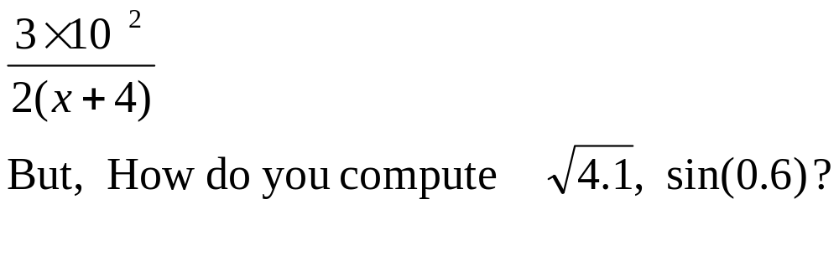
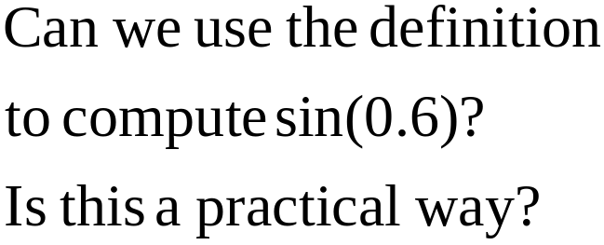
Motivation
We can easily compute expressions like:
b
a
0.6

Slide 3
Remark
In this course, all angles are assumed to be in radian unless you are told otherwise.

Slide 4
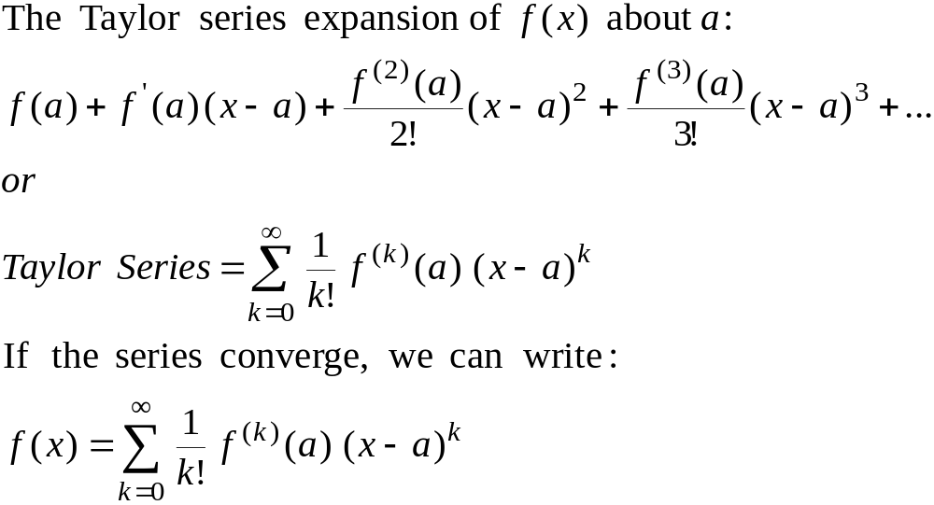
Taylor Series

Slide 5
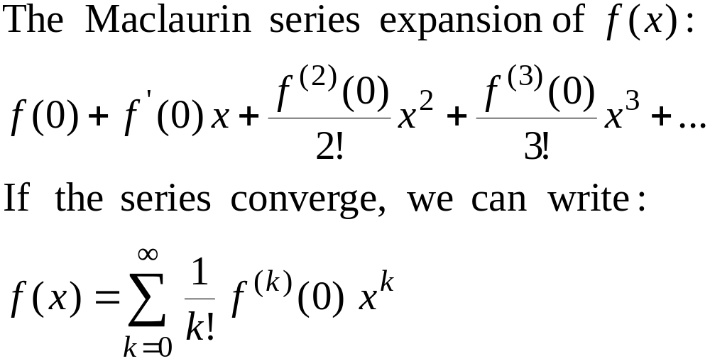
Maclaurin Series
Maclaurin series is a special case of Taylor series with the center of expansion a = 0.

Slide 6
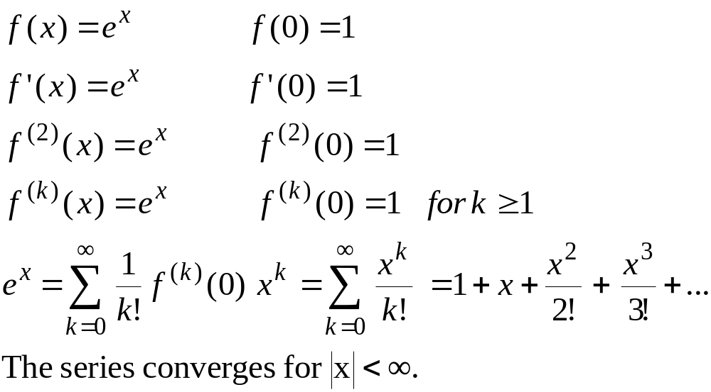
Maclaurin Series – Example 1

Slide 7
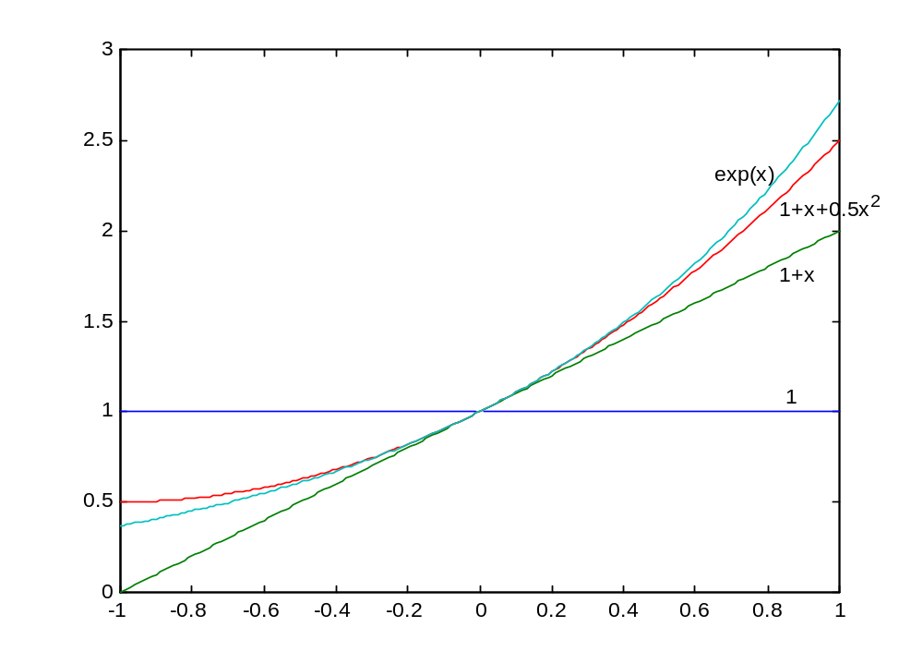
Taylor Series
Example 1

Slide 8
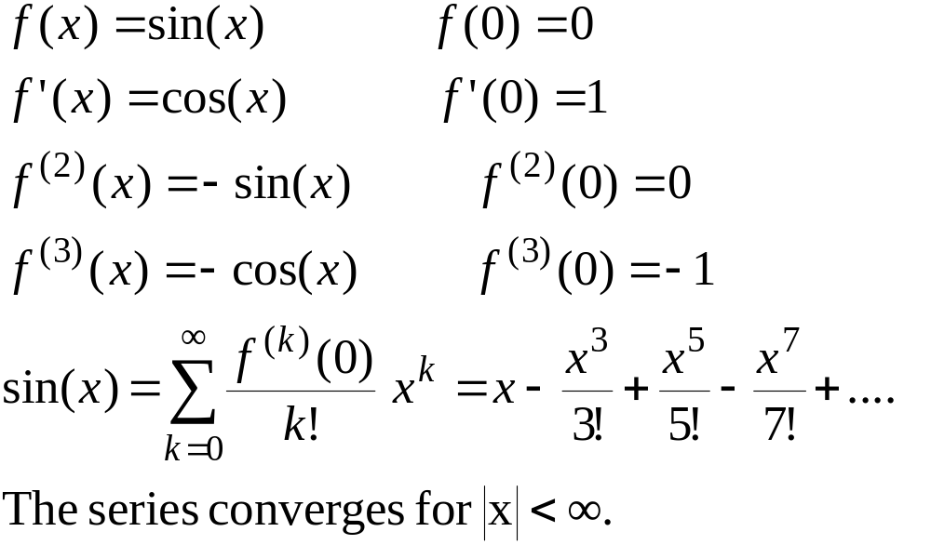
Maclaurin Series – Example 2

Slide 9
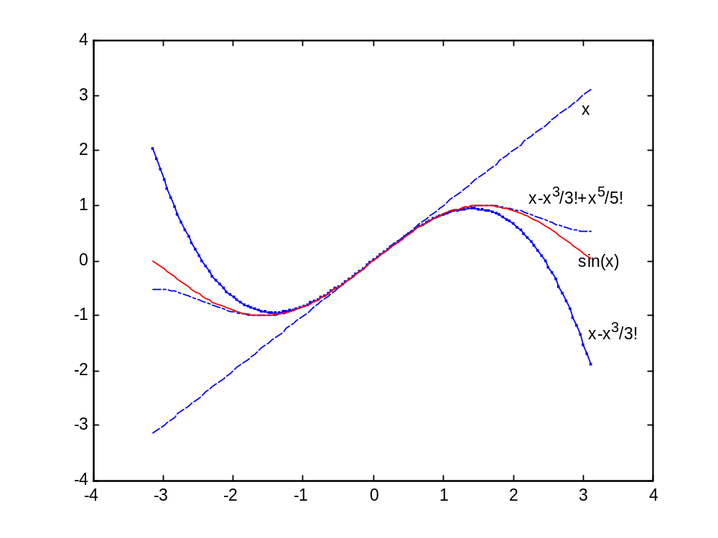

Slide 10
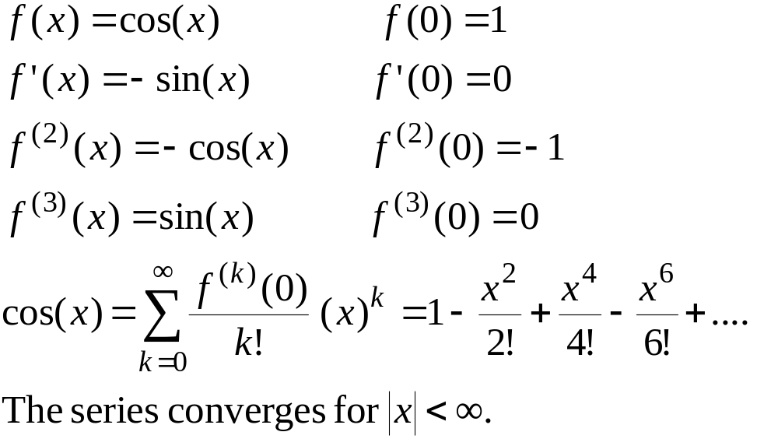
Maclaurin Series – Example 3

Slide 11
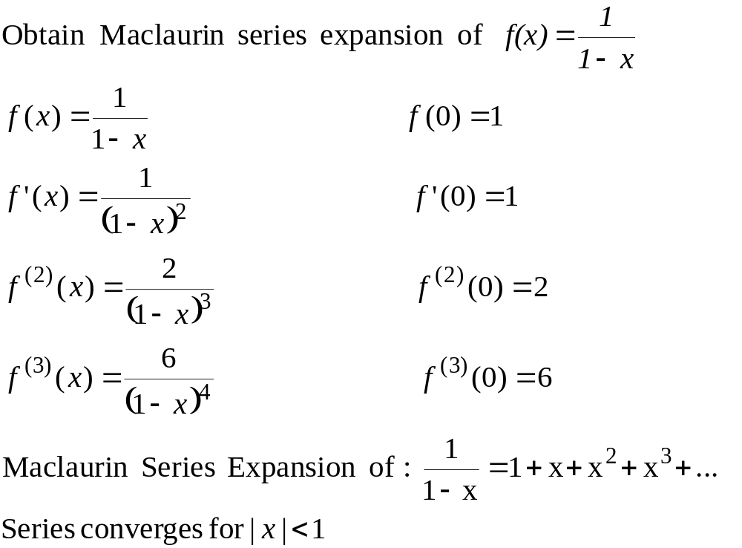
Maclaurin Series – Example 4

Slide 12
Example 4 - Remarks
Can we apply the series for x≥1??
How many terms are needed to get a good approximation???
These questions will be answered using Taylor’s Theorem.

Slide 13
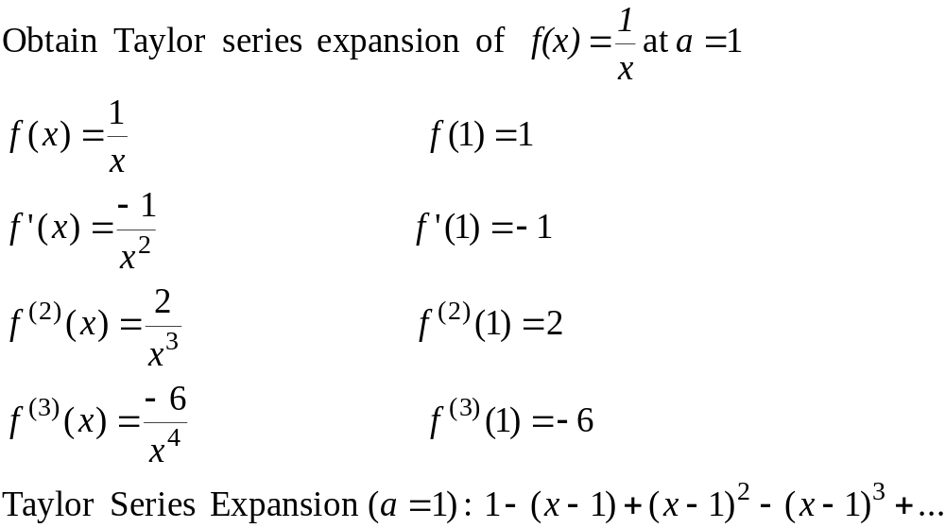
Taylor Series – Example 5

Slide 14
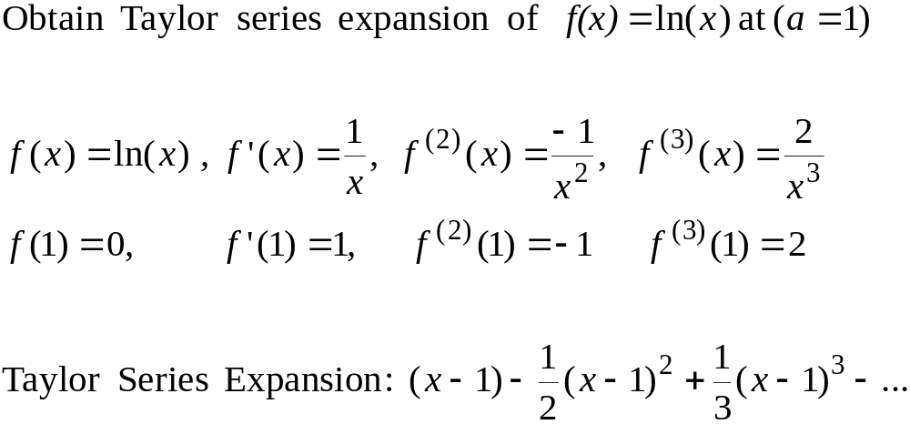
Taylor Series – Example 6

Slide 15
Convergence of Taylor Series
The Taylor series converges fast (few terms are needed) when x is near the point of expansion. If |x-a| is large then more terms are needed to get a good approximation.

Slide 16
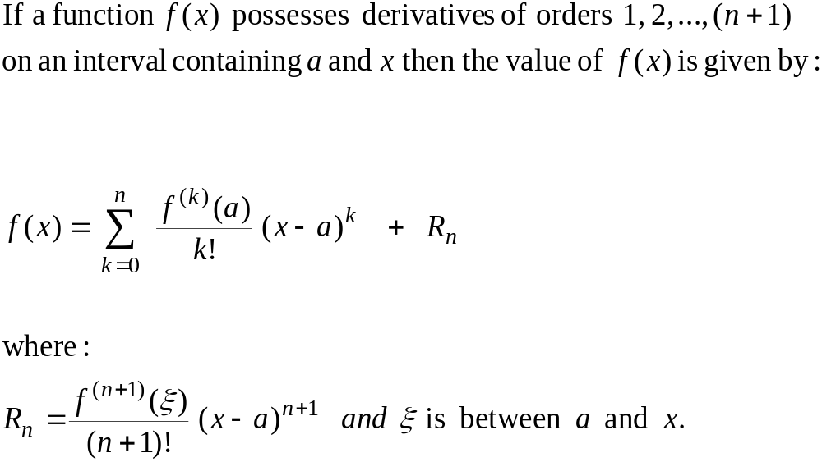
Taylor’s Theorem
(n+1) terms Truncated Taylor Series
Remainder

Slide 17
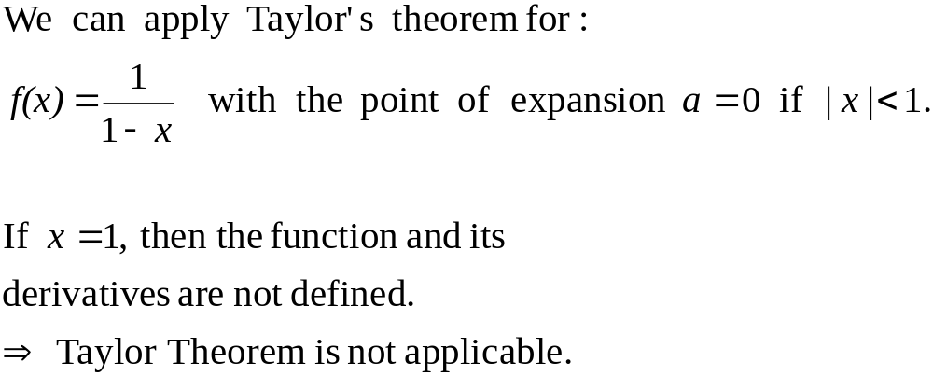
Taylor’s Theorem

Slide 18
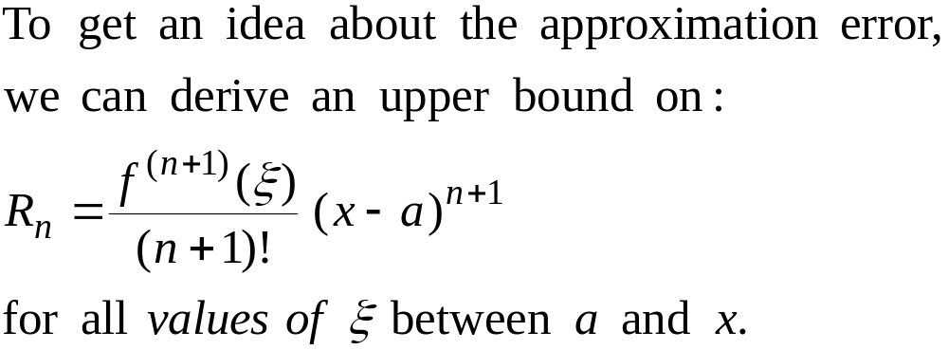
Error Term

Slide 19
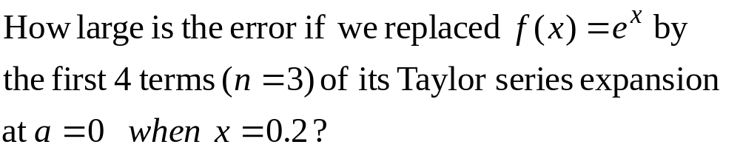
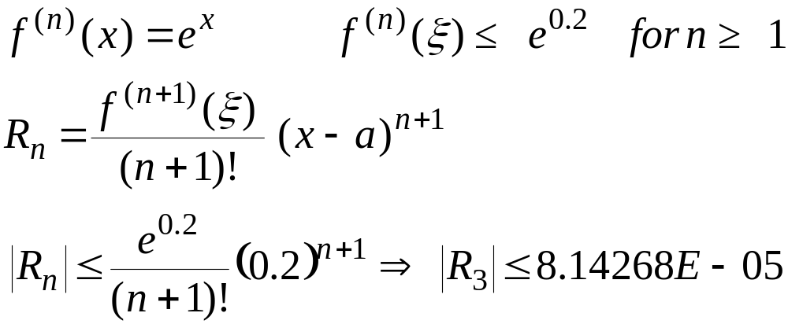
Error Term - Example

Slide 20
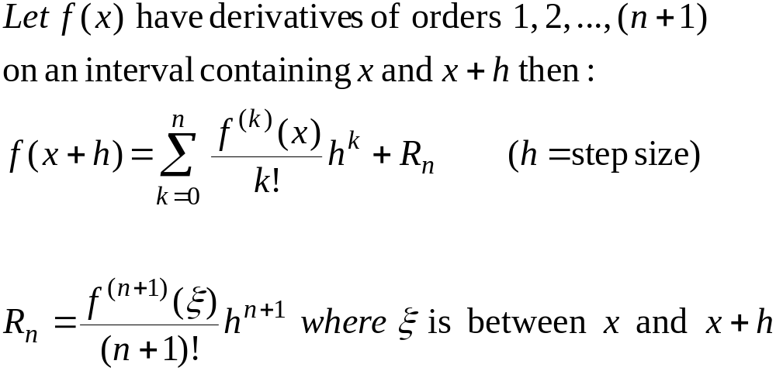
Alternative form of Taylor’s Theorem

Slide 21
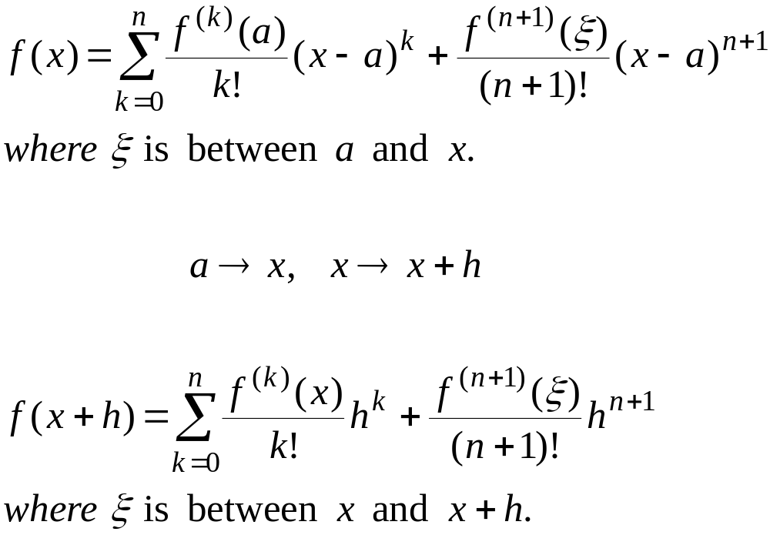
Taylor’s Theorem – Alternative forms

Slide 22
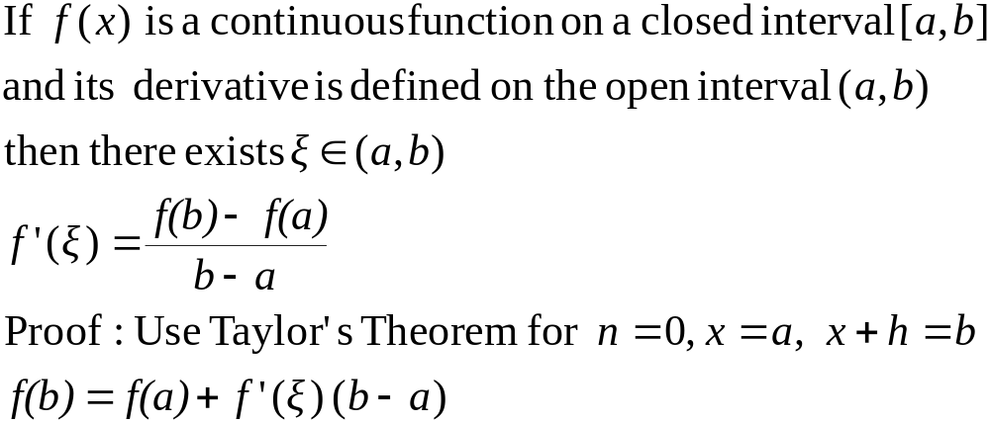
Mean Value Theorem

Slide 23
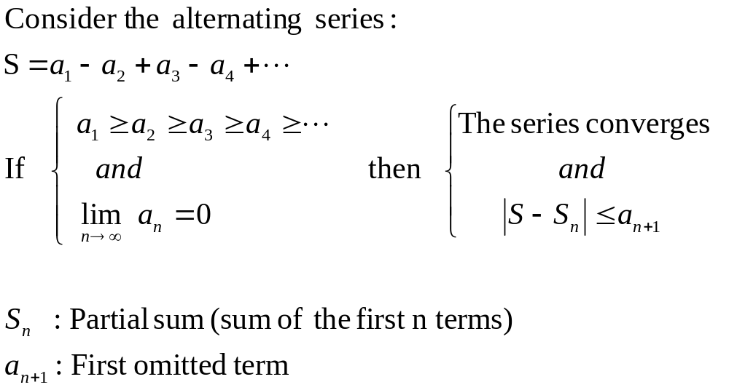
Alternating Series Theorem

Slide 24
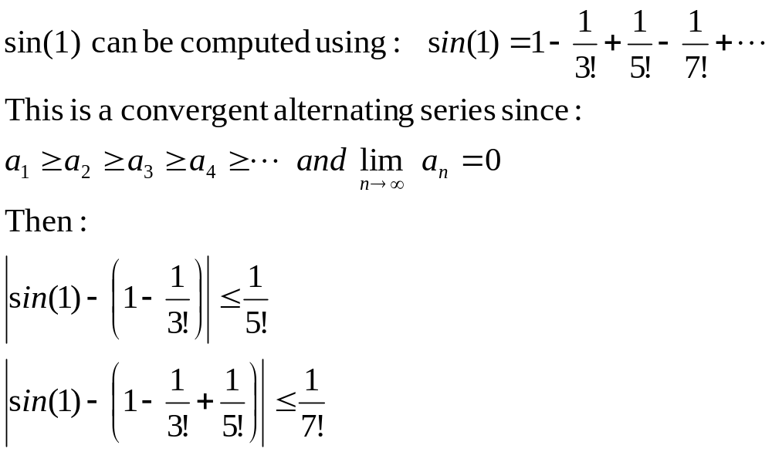
Alternating Series – Example

Slide 25
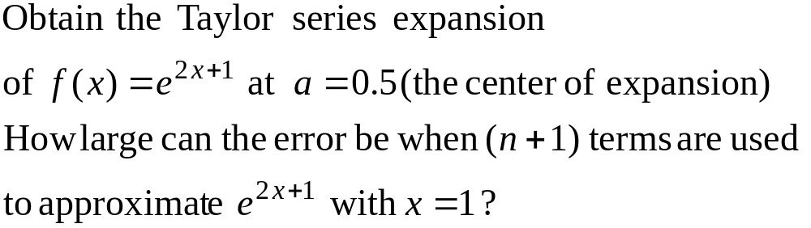
Example 7

Slide 26
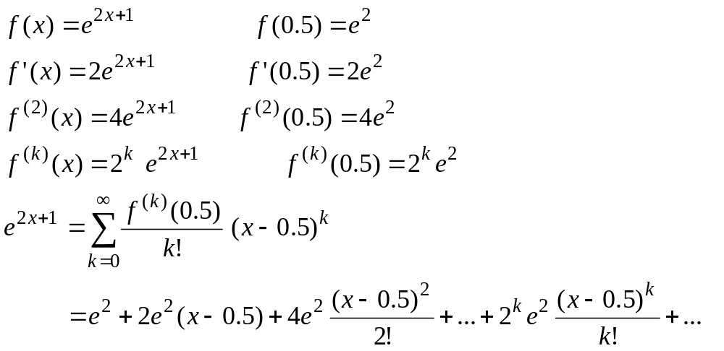
Example 7 – Taylor Series

Slide 27
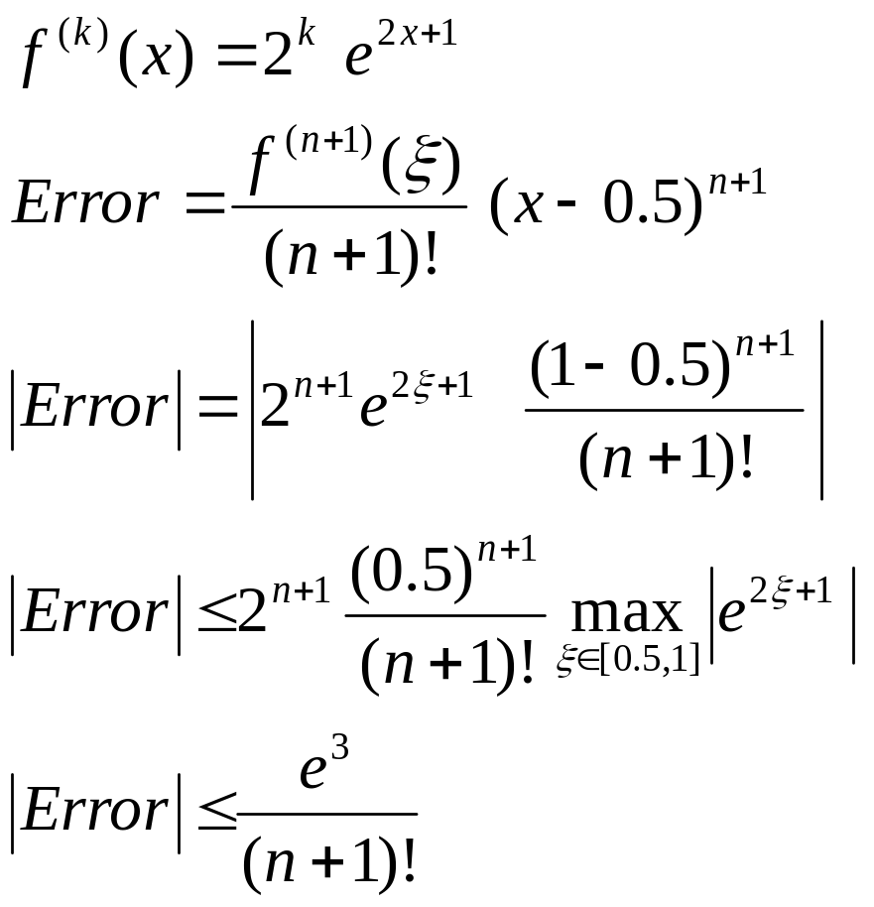
Example 7 – Error Term

